Slide 1
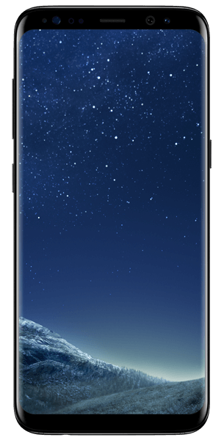
PRABHU JAGATBANDHU COLLEGE
Lecturer:- YOUSUF KHAN
Semester:- 2nd
Subject:- E-Commerce
Chapter:-
Digital Payment

Slide 2
What is a Digital Payment ?
To put it in simple words, a digital payment occurs when goods or services are purchased through the use of various electronic mediums. There is no use of cash or cheques in this type of payment method.
What is a Cashless Economy ?
In a cashless economy, all transactions are carried out using different types of payment methods and this does not involve the physical use of money for the purchase of various goods and services.

Slide 3
Store value card [Smart card]
Payment Card [Credit and Debit Card]
Methods Of E-Payment
Electronic or Digital Cash
Store value card [Smart card]
Electronic or Digital Wallet

Slide 4
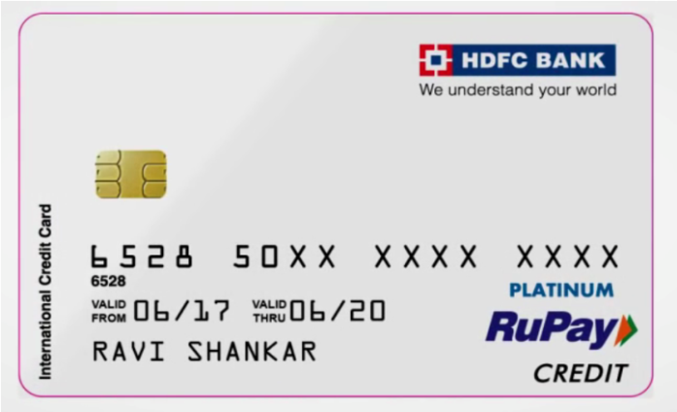
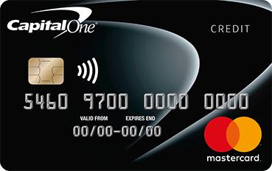
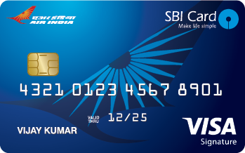
1. Payment Card [Credit and Debit Card]
a) Credit Card:-
Credit card are very commonly used as a tool for electronic payment.
It is a thin plastic card that can be used to buy items, meet food or restaurant bills, booking of airline tickets etc. Any credit card allows a user to pay later for the items one has bought or the services availed, hence the name credit card is given. This process of payment is known as charging. Charging means that one user had paid for the items his or her credit card by promising to pay when the user had signed the credit card receipt. Credit card are normally issued from a bank or any authorized authority.

Slide 5
1. Payment Card [Credit and Debit Card]
Security issues while using Credit card-
Taking Care of one’s credit card receipts.
The credit card should not be out of one’s sight.
Losing a credit card.
Keeping two different credit card in different place while travelling.
Security issues while shopping online.
Taking care of old / previously used credit cards.

Slide 6
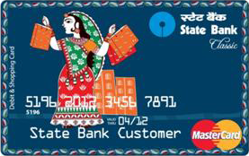
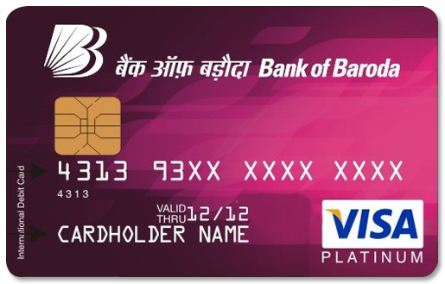
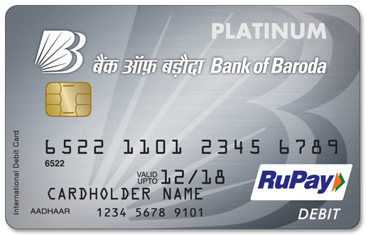
1. Payment Card [Credit and Debit Card]
b) Debit Card:-
A debit card (also known as a bank card, plastic card or check card) is a plastic payment card, that can be used instead of cash when making purchases. It is similar to a Credit card, but unlike a credit card, the money comes directly from the user's bank account, when performing a transaction.
Payments using a debit card are immediately transferred from the cardholder's designated bank account, only if sufficient balance is available, If not the transaction will be failed.
Debit cards usually also allow for instant withdrawal of cash, acting as an ATM card for withdrawing cash.

Slide 7
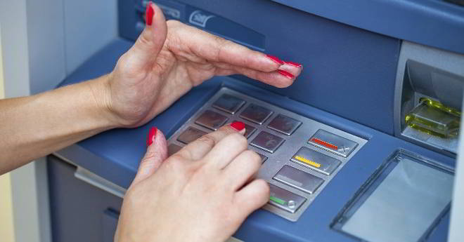
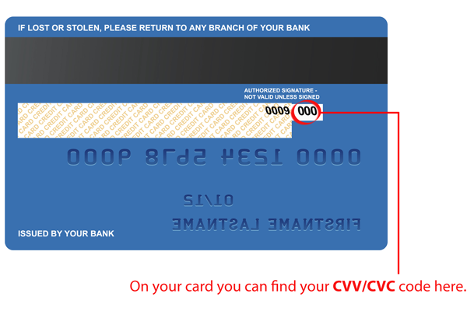
1. Payment Card [Credit and Debit Card]
Security issues while using an ATM cum debit card-
PIN Number
CVV Number
Change default PIN
Card and PINs are kept Separate.
Call the Helpline Immediately needed.
Apply for Mobile Alerts
Follow Rules

Slide 8
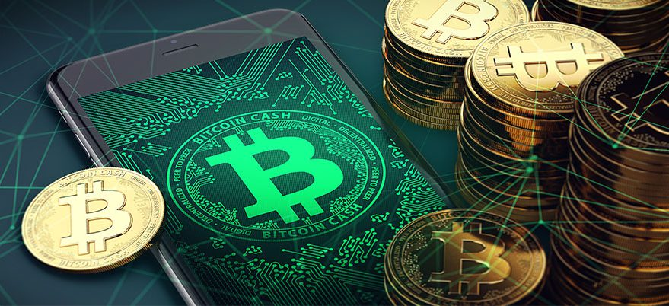
2. Electronic or Digital Cash
Digital cash refers to a format of electronic data that is similar in functions like that of our traditional paper cash. Digital cash can be stored, Transferred , paid and verified electronically through the use of different digital devices such as Computers, Mobile phones etc.

Slide 9
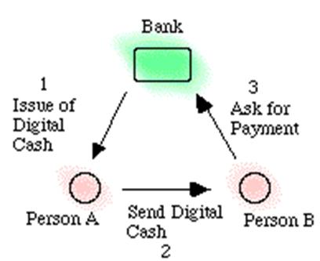
2. Electronic or Digital Cash
Points to remember-
Like traditional paper cash, the model of digital cash also involves three parties- Customer, Trader and Bank.
The digital cash can not be manipulated and refused by a user illegally.
Digital cash ensures privacy or untraceability.
The digital cash can be transferred between different customer without involvement of the bank before finally deposited into the customer’s bank A/c
Trader can verify the validity of e cash without involvement of the bank.
Without the bank’s interference, a user can subdivide an amount of e-cash in a given amount into smaller subdivisions of e-cash.
the security of e-cash does not depend on any physical or geographical locations or special devices.

Slide 10
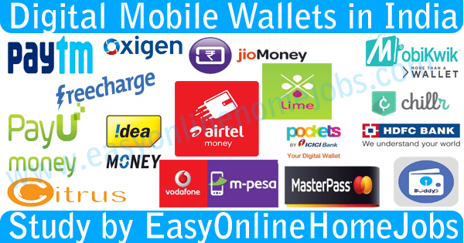
3. Electronic or Digital wallet
An electronic wallet or E-wallet is defined as an encrypted medium for storage or holding credit card and other confidential financial information that can be used to complete electronic transactions without re-entering the stored data at the time of transaction itself. Access to E-wallet requires password or “keys”.

Slide 11
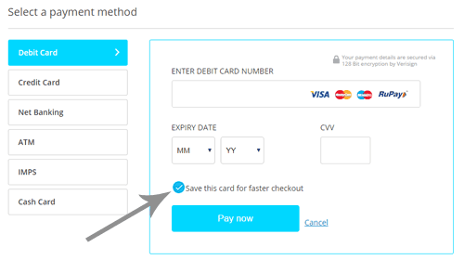
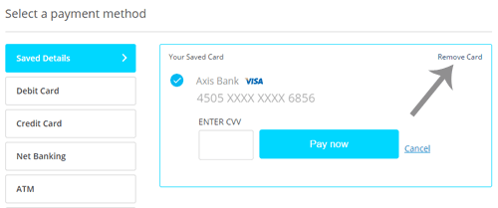
3. Electronic or Digital wallet

Slide 12
3. Electronic or Digital wallet
Functions of Digital wallet
Managing of one’s payment and accounts.
Getting of offers from traders one knows and can depend upon.
Storage of digital receipts and warranty information.
Getting of alerts about one’s account and one’s spending.
Security issues associated with Digital wallets
Providing protection through password as well as providing physical protection to the devices which are to be used to access the payment options such as PC, mobile phones, laptops, tablets etc.
Only the owner can access sensitive information such as including User name, password, PINs and answers to security options.

Slide 13
3. Electronic or Digital wallet
Advantages of Using Digital Wallet
Time Saving- Many times when you go for online shopping or for mobile recharge, you even wouldn’t have time to enter your Credit card details.
Security
Track the Expenditure
Attractive Discounts- If you’re using digital wallet of any online wallet provider, you may find some discounts
Disadvantages of Using Digital Wallet
International Restriction- Every country has different services and so the different digital wallets.
Limited Merchants
Dependent on the Devices
Danger of Losing your Money

Slide 14
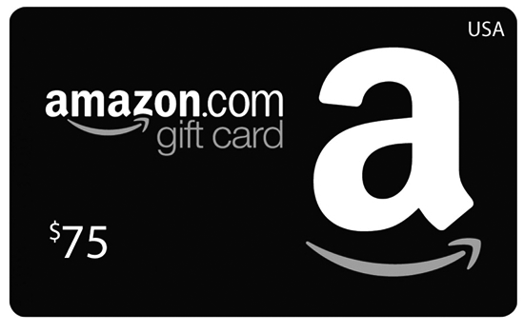
4. Stored value Card (Smart card)
A stored-value card is a payments card with a monetary value stored on the card itself, not in an external account maintained by a financial institution. Stored-value cards differ from debit cards, where money is on deposit with the issuer, and credit cards which are subject to credit limits set by the issuer. Another difference between stored-value cards and debit and credit cards is that debit and credit cards are usually issued in the name of individual account holders, while stored-value cards may be anonymous, as in the case of gift cards. Stored-value cards are prepaid money cards and may be disposed when the value is used, or the card value may be topped up, as in the case of telephone calling cards or when used as a fare cards.
Like Amazon gift card, Metro ticket cards, Big bazar cards.
These cards are two type-
Closed loop Stored value Card .
Open Loop Stored value Card .

Slide 15
5. E - Money
Electronic money is money which exists in banking computer systems and is available for transactions through electronic systems. Its value is backed by fiat currency and it can be exchanged into physical form however its uses are often more convenient electronically.
E – Money in India
At the end of May 2017, Paytm – India’s largest mobile money company – launched Paytm Payments Bank, having received the last clearance from the Reserve Bank of India (RBI). “We wish to acquire 500 million new customers and launch a slew of financial services products such as deposits, wealth management, insurance, financial lending and many more,”
E- money is therefore not a result of demonetization, but it has taken off following the controversial move by the Indian government to remove Rs500 and Rs1,000 notes from circulation. Prevention of corruption and the spread of black money, choking terror funding, and the creation of a cashless society were the main objectives of the demonetization measure.

Slide 16
THANK YOU

