Slide 1
How to make PEOPLE’S BIODIVERSITY REGISTER
DR. SARADA MANDAL
Associate Professor in Geography, Prabhu Jagatbandhu College
2018

Slide 2
Ref. http://nbaindia.org/uploaded/pdf/ PPT_PBRs_Guidelines.pdf

Slide 3
Ref. http://nbaindia.org/uploaded/pdf/ PPT_PBRs_Guidelines.pdf
The Register shall contain comprehensive information on availability and knowledge of local biological resources, their medicinal or any other use or any other traditional knowledge associated with them.

Slide 6
Ref. http://nbaindia.org/uploaded/pdf/ PPT_PBRs_Guidelines.pdf
PBR is not a mere documentation exercise but be used to develop an agenda for conservation action, based on local knowledge and BRs.
PBR can also be as part of secondary/tertiary education/curriculum.
Fellowships for taxonomists by Boards/NBA and their recruitment to State Boards need to be thought of.

Slide 7
Courtsey: Dr. Anandita Dawn, Prabhu Jagatbandhu College

Slide 8
Courtsey: Dr. Anandita Dawn, Prabhu Jagatbandhu College

Slide 9
Courtsey: Dr. Anandita Dawn, Prabhu Jagatbandhu College

Slide 10
Tips for preparing Population Scape
It is a type of biodiversity register, which can be easily prepared from
the student database (collected from College office)
Questionnaire survey
Some times it can focus on
particular heritage, cultural practice, historical traditions, beliefs etc.
unique characteristics of habitat, ecological history etc.

Slide 11
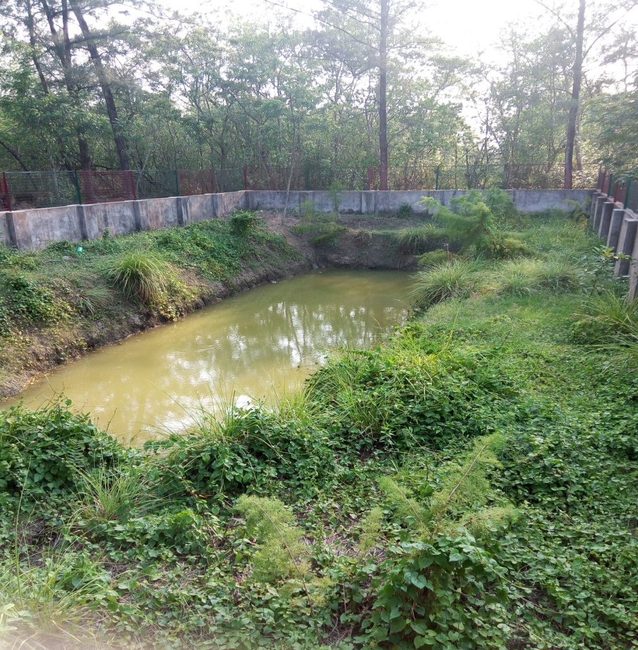
Tips for preparing Floral /Faunal Diversity
Preparing this type of register is actually a unique opportunity to open our eyes and ears.

Slide 12
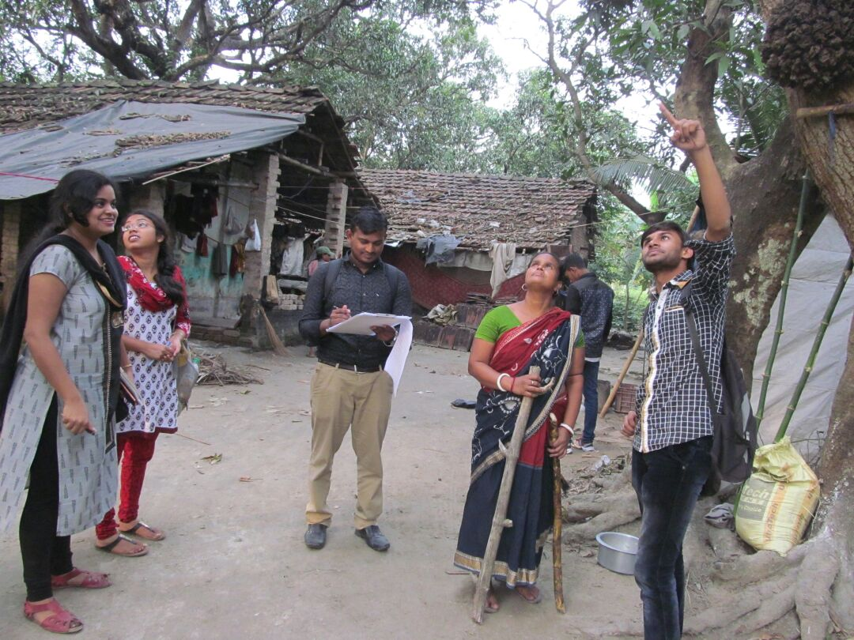
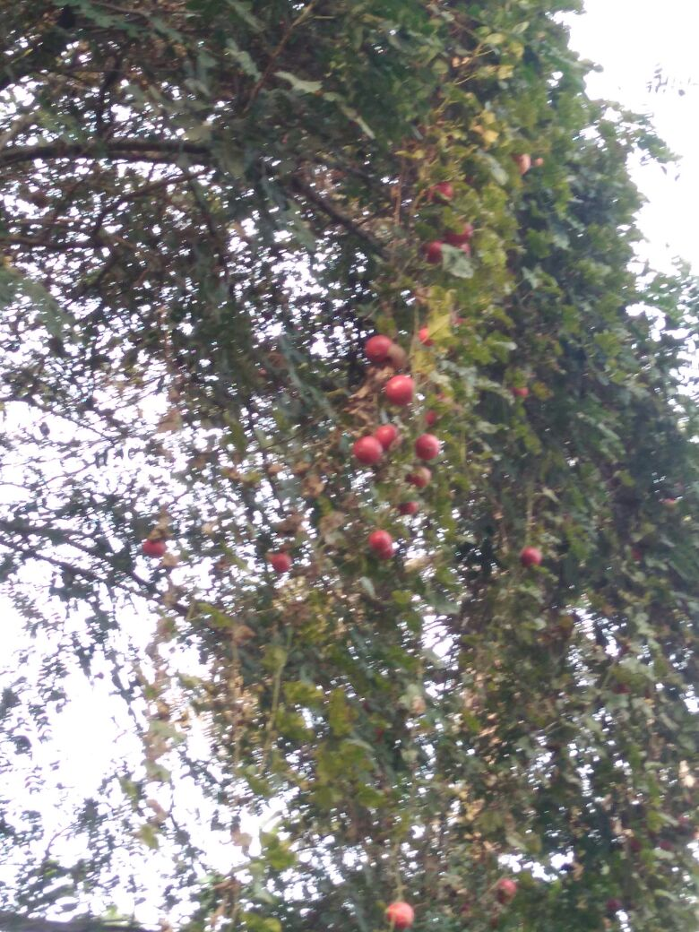
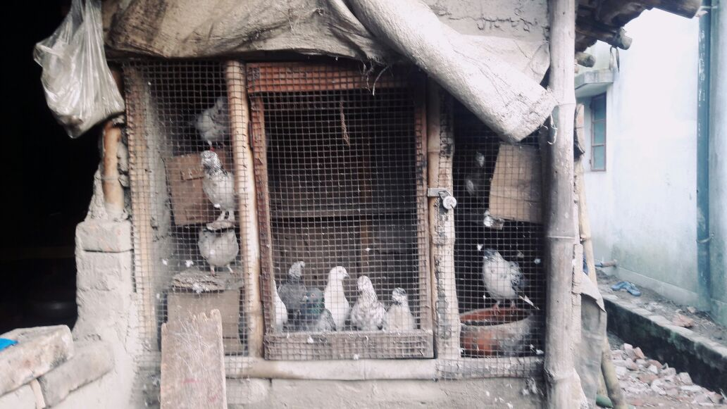
Tips for preparing Floral /Faunal Diversity
Preparing this type of register is actually a unique opportunity to develop our over all sense to witness the magic of nature.

Slide 13
Instructions for the students
Do s
Don’t s
So Students, let us walk around outside space of your home or college.
Take a clip board, a paper with worksheet table drawn on it and off course a pen.
Watch the bio-diversity and take a note for each of them.
If you fail to identify any floral or faunal types, kindly take help from the local people.
You may take a photograph or take help from experts later.
Do not pluck the leaves or flowers.
Do not disturb the animals.
Do not leave any plastic items.
Do not damage the nature.

Slide 14
Wish you Good Luck for preparing an effective PBR

