Slide 1
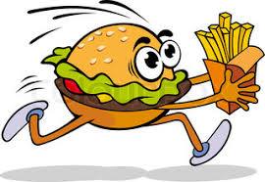
INTRODUCTION OF BIOMOLECULES
CARBOHYDRATES

Slide 2
Biomolecule is the molecule that is present in all living organisms, involved in the maintenance and metabolic process
                6
All Biomolecule contain CARBON C
12
Carbon is the most versatile and prominent element of life
Other elements –
HYDROGEN(H)
OXYGEN(O)
NITROGEN (N)
SULPHUR (S)
SODIUM (Na)
CALCIUM (Ca)
MAGNESIUM (Mg)

Slide 3
BIOMOLECULES
BIOMOLECULES
INORGANIC
ORGANIC
CARBOHTDRATES
LIPIDS
PROTEINS
NUCLIC ACIDS
ENZYMES
VITAMINS
These are very large molecules of many ATOMS covalently bonded
ENERGY is stored in the COVALENT BONDS. When we eat ,we get ENERGY to lives because chemical reactions within our bodies break these bonds
Notes:
Energy is stored in the Covalent Bonds.When we eat ,we get ENERGY to lives because chemical reactions within our bodies break these bonds.

Slide 4
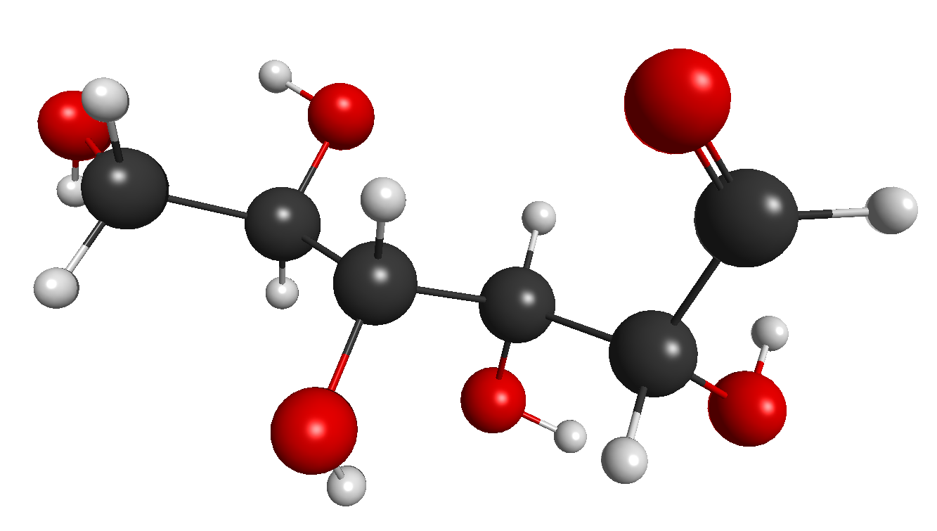
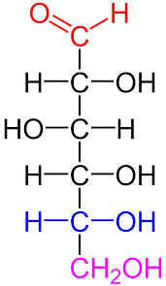
Carbohydrates

Slide 5

CARBOHYDRATES
THE MOST ABUNDANT ORGANIC MOLECULES IN NATURE
HYDRATE DE CARBON i.e. HYDRATE OF CARBON or
Cn(H2O)n
Main source of ENERGY
Provide some STRUCTUR
PRECURSORs of many organic compounds – FATS, AMINO ACIDS
STORAGE FORM of ENERGY
(Glycogen Animals)
(Starch Plants)

Slide 6
CARBOHYDRATES
SIMPLE
MONOSACCHARIDE – GLUCOSE,
FRUCTOSE,
GALACTOSE
OLIGOSACCHARIDE –
RAFFINOSE
STACHYOSE
COMPLEX
POLYSACCHARIDE – STARCH,
GLYCOGEN,
CELLULOSE,
DEXTRIN
DISACCHARIDE – MALTOSE, SUCROSE, LACTOSE
Notes:
lmnbh

Slide 7
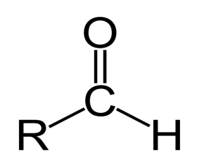
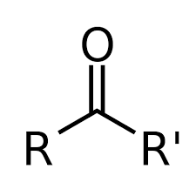
MONOSACCHARIDES
BASED ON No OF C ATOMS BASED ON FNCTIONAL GROUP
TRIOSES (C3H6O3) –GLYCERALDEHYDE, ALDOSE-GLECEALDEHY,
DIHYDROXYACETONE GLUCOSE
TETROSE (C4H8O4) – ERYTHROSE,
THREOSE
PENTOSE (C5H10O5) – RIBULOSE,
ARABINOSE
HEXOSES (C6H12O6) – GLUCOSE, KETOSE – DIHYDROXYACETONE,
FRUCTOSE, FRUCTOSE
GALACTOSE
HEPTOSES (C7H14O7) – GLUCOHEPTOSE
SO ON………

Slide 8
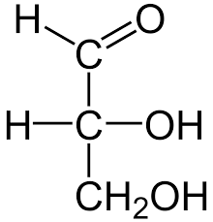
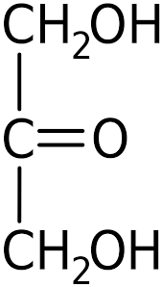
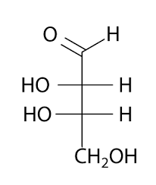
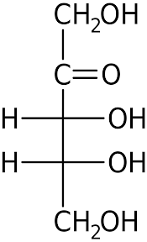
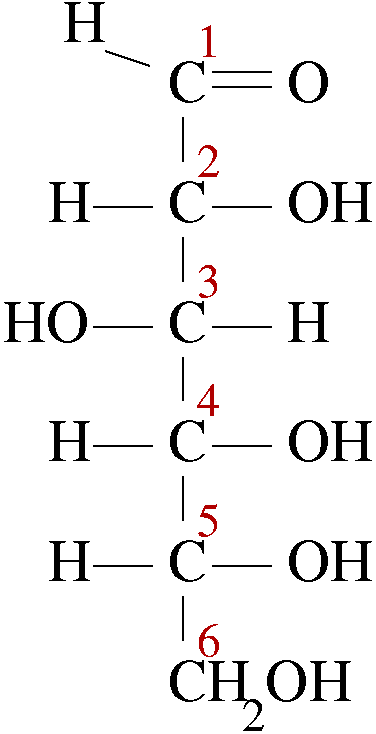
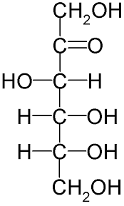
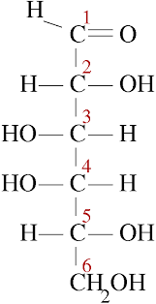
SOME STRUCTURE OF MONOSACCHARIDE
GLYCERALDEHYDE DIHYDROXYACETONE ERYTHROSE RIBULOSE
GLUCOSE FRUCTOSE GALACTOSE

Slide 9
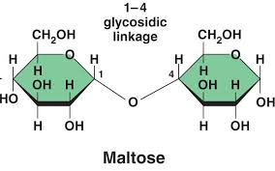
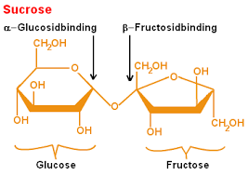
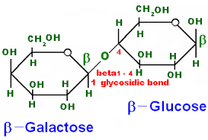
OLIGOSACCHARIDES
CARBOHYDRATES THAT CONTAINS 2-9 MONOSACCHARIDE UNITS CONNECTED BY GLYCOSIDIC LINKAGE.
DISACCHARIDES : 2 MONOSACCHARIDE UNITS ( SIMILAR OR DISSIMILAR )
CRYSTALLINE, WATER SOLUBLE, SWEET IN TASTE
MALTOSE : MALT SUGAR , SUCROSE : CANE SUGAR LACTOSE : MILK SUGAR
Notes:
DISACCHARIDES

Slide 10
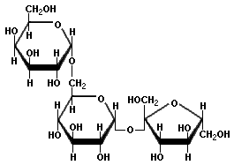
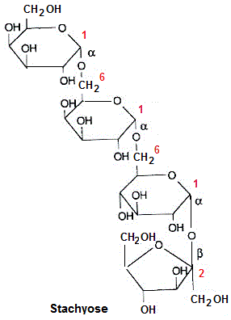
TRISACCHARIDES TETRASACCHARIDES
RAFFINOSE
THE SMALLEST AND THE COMMONEST OLIGOSACCHARIDES ARE DISACCHARIDES

Slide 11
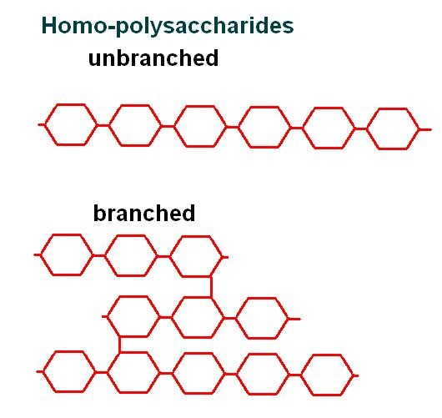
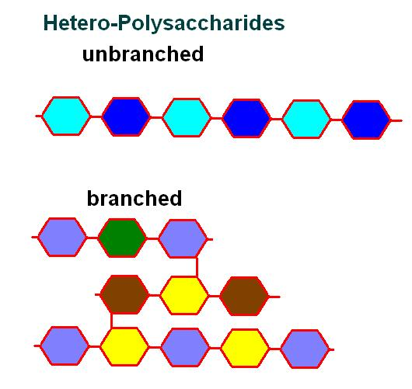
POLYSACCHARIDES
KNOWN AS GLYCANS
REPEATING MONOSACCHARIDE UNITS CONNECTED BY GLYCOSIDIC BONDS
ALMOST INSOLUBLE
NOT SWEET
IDEAL STORAGE AND STRUCTURAL COMPONENTS
2 TYPES –
a) HOMOPOLYSACCHARIDES b) HETAROPOLYSACCHARIDES
( ONLY ONE TYPE OF MONOSACCHARIDE (CONDENSATION OF 2 OR MORE TYPES
MONOMERS ) OF MONOSACCHARIDES)
STARCH, GLYCOGEN, CELLULOSE PEPTIDOGLYCAN, HYALURONIC ACID,
AGAR, CHITIN
Notes:
POLYSACCHARIDES

Slide 12
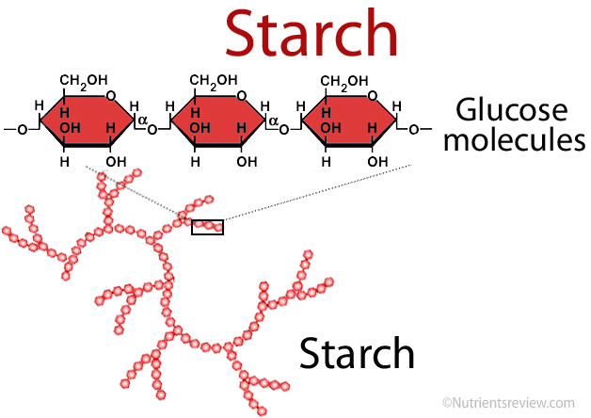
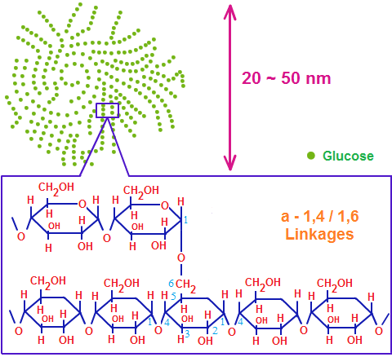
STORAGE POLYSACCHARIDES
STRACH = AMYLOSE + AMYLOPECTIN
CARBOHYDRATE RESERVE OF PLANTS
IMPORTANT DIETARY SOURCE FOR ANIMAL
HOOPOLYMER OF GLUCOSE : GLUCAN
GLYCOGEN
CARBOHYDRATE RESERVE IN ANIMAL : ANIMAL STRACH
HIGH CONCENTRATION IN LIVER, MUSCLE , BRAIN
MADE UP OF GLUCOSE UNIT

Slide 13
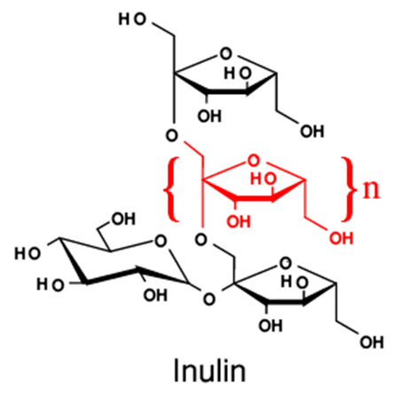
INULIN
POLYMER OF FRUCTOSE : FRUCTOSAN
FOUND IN DAHLIA, GARLIC, ONION etc
NOT REDAILY METABOLISED IN HUMAN BODY
READILY FILTERED THROUHG THE KIDNEY; USED FOR KIDNEY FUNCTION TEST

Slide 14
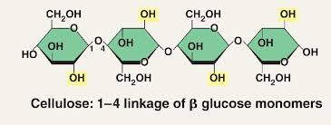
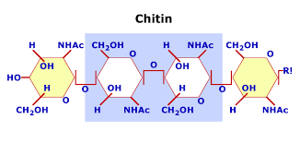
STRUCTURAL POLYSACCHARIDES
CELLULOSE
MOST ABUNDANT ORGANIC SUBSTANCE IN PLANT KINGDOM
PREDOMINANT CONSTITUENT OF PLANT CELL WALL
TOTALLY ABSENT IN ANIMALS
CHITIN
SECOND MOST ABUNDANT ORGANIC SUBSTANCE
COMPLEX CARBOHYDRATE OF HETAROPOLYSACCHARIDE
FOUND IN INSECTS ,PROVIDE STRENTH AND ELASTICITY

Slide 15

THANK YOU………

