Slide 1
Limits to growth and sustainable use of resources

Slide 2
Limit of Growth
The Limits to Growth is a 1972 book modeling the consequences of a rapidly growing world population and finite resource supplies, commissioned by the Club of Rome. Its authors were Donella H. Meadows, Dennis L. Meadows, Jørgen Randers, and William.
June 1, 2004 by Chelsea Green Publishing Company and Earthscan under the name Limits to Growth: The 30-Year Update. Donnella Meadows, Jørgen Randers, and Dennis Meadows have updated and expanded the original version.

Slide 3
“Limits to Growth," the report was called, and besides a shock it also caused outrage worldwide. Several years after the first phase of environmental awareness and shortly before the first oil crisis (1973), "Limits" brought the message that the world was heading for disaster because of unfettered population growth and industrial expansion, exhaustion of stocks of natural resources, environmental destruction, and food shortages.
"Limits" was based on a so-called simulation model, a mathematical representation of the main variables and their dynamic interactions known as the WORLD III model. Some of the key features of these dynamics are feedback loops, which show that an intervention in one part of a system has unexpected effects on other variables of that system.

Slide 4
“Limits" became the subject of heated controversy, and the Club of Rome (www.clubofrome.org) soon gained the reputation of being a neo-Malthusian movement of doomsayers. The report became world famous, an indication that its message was not only controversial but also supremely recognizable.
Although thousands of scientists have devoted their efforts to the question of how reliable WORLD III was and whether it is even at all possible to forecast the future in this manner, "Limits" has, in our view, come through all the criticism untarnished. In the first place, because the primary aim was not to make a prediction but "to improve the insight," in the words of Jay Forrester, one of the contributing authors; and secondly, because nobody has yet really succeeded in finding fault with the main calculations and the underlying hypotheses

Slide 5
WHAT HAPPENS IF WE FAIL IN THIS QUEST?
In the first place, we would reiterate our original message; in the words of Jay Forrester: "Over the last hundred years, life on earth was dominated by growth. Growth of population, of production, of income and capital formation, of exhaustion and pollution. This growth is going to stop and must stop, and the only question is by what means? Voluntarily, by government and free will, or through natural processes, which means collapse and disaster?“
Ultimately, this is the vision of the future, and many elements of it have already become reality in the world around us: collapse of life-support systems, of communities, regions and nations, lack of food, scarcity of water, climate change and, ultimately, war. Of the approximately 100 wars now being fought in the world, more than 70 percent originate in part in exhausted resources and collapsing life-support systems. This is the ultimate consequence, clearly confirmed by such authors as Meadows, Kennedy, Kaplan, and c others

Slide 6
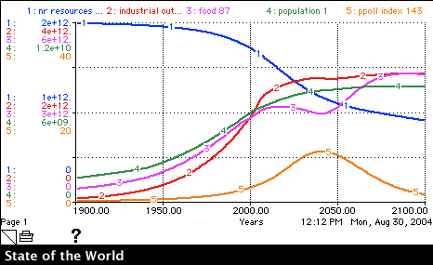
Sustainable Development
Food
Population
Resources
Pollution

Slide 7
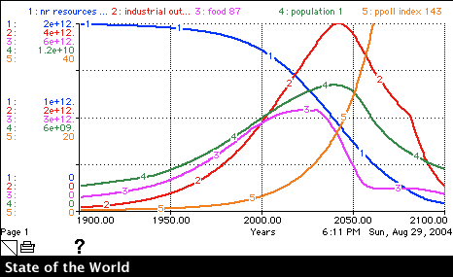
Overshoot and Collapse
“Limit”
Pollution
Population
Industrial Output
Food
Resources

Slide 8
Club of Rome Statement
Our world model was built specifically to investigate five major trends of global concern – accelerating industrialization, rapid population growth, widespread malnutrition, depletion of nonrenewable resources, and a deteriorating environment.

Slide 9
Three Changes
In 1972 global population and material & energy usage were below sustainable levels; now they are above. In 1972 we needed to slow down before we overshot; now we need to get back down from being in overshoot.
In 1972 the model showed a time of crises 50-70 years into the future; now the crises appear 10-30 years in the future.
In 1972 we changed technology before it was needed and without cost; now we recognize the delays and the costs.

Slide 10
Some Indicators of Overshoot
Deterioration in renewable resources - surface and ground water, forests, fisheries, agricultural land.
Rising levels of pollution.
Growing demands for capital, resources, and labor by military and industry to secure, process, and defend resources.
Investment in human resources (education, shelter, health care) postponed in order to provide immediate consumption and security demands.
Rising debt; eroding goals for health and environment.
Growing instability in natural ecosystems.
Growing gap between rich and poor - between the powerful and the weak. Meadows, et. al. pp 176-177.

Slide 11
Carrying capacity
The term "carrying capacity," long known to ecologists, has also recently become popular. It "refers to the limit to the number of humans the earth can support in the long term without damage to the environment." (Giampietro, et. al. 1992).
The troublesome phrase here is "without damage to the environment." One damages the environment when one kills a mosquito, builds a fire, erects a house, develops a subdivision, builds a power plant, constructs a city, explodes a nuclear weapon, or wages nuclear war. Which, if any, of these things takes place "without damage to the environment?"

Slide 12
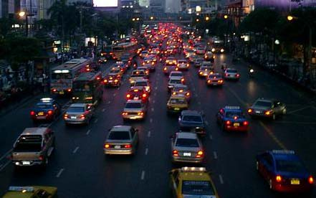
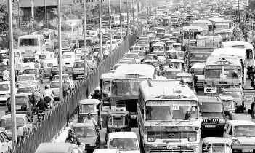
Sustainability and Resource Use
SUSTAINABLE RESOURCE USE

Slide 13
Technology:
Some Preliminary Considerations
1. Environmental damage and environmental injustice
caused by developing technologies, using them, and
disposing of their by-products, their pollutants, and
ultimately the technologies themselves.
2. Social, political, and economic consequences of
technology development, use, and disposal.
3. Measuring progress by our ability to develop and
consume technologies.

Slide 14
The Technological Vision
Progress is defined as acquiring:
1. the most numerous,
2. the widest variety,
3. and the very latest or most refined commodities
that are:
a. easier to use,
b. more instantaneous,
c. more pervasive,
d. and safer than what you
presently own.

Slide 15
So what is sustainability?
The ability in which something can be preserved.
Living in a way in which the environment may last for an infinite time and many generations may enjoy it.
The effort to use minimally the resources of our world, as they are necessary to support life, without compromising the future of said resources for future generations.
To maintain continuously.

Slide 16
Future Generations of People
What is a future generation?
Do we have any moral responsibilities to future generations? Why or why not?
What will future generations need and want?

Slide 17
Why we might not have moral responsibilities to future generations
1. Argument from Ignorance
2. Argument from Disappearing Beneficiaries
3. Argument from Temporal Location

Slide 18
Why we might have responsibilities to future generations
1. Future people might be owed a reasonable
hope of ☺ (Utilitarianism)
2. Future people might have rights that need to be
respected (Human Rights)
3. We might care about who future people are (Care
Ethic)

Slide 19
Five Central Problems
1. Ignorance Problem: How can we know what future people will really
need and want, what rights they might insist upon, and what they
will blame us for doing right and wrong?
2. Typology of Effects Problem: How can we determine which of our
actions will really have moral implications for the future?
3. Problem of Intergenerational Trade-Offs: How should a particular
generation balance concern for its own moral and prudential
concerns with concern for future generations?

Slide 20
Five Central Problems continued
4. Distance Problem: How far into the future do
our moral obligations extend?
5. Saving Stuff Problem: What should we save for
future generations—actual natural resources or monetary investments?

Slide 21
Two Kinds of Sustainability
Substitutability: Are natural resources—from the more-than-human world—interchangeable with human-produced goods and monetary assets?
Weak Sustainability: Yes! All we need to sustain are non-declining stocks of utility for people.
Strong Sustainability: No! We need to sustain (at least some of) the more-than-human world.

Slide 22
Some Preliminary Considerations about Sustainable Resources
Population growth, increasing affluence, and the creation of new technologies usually increase the energy supply needed to sustain people.
The scale of the operation of maintaining and increasing energy supplies for people leads to moral demands for increasing efficiency and curtailing pollution.
The complex interplay of economics, politics, and other social factors, combined with biophysical and ecological considerations, results in much uncertainty about the future consequences of our actions and decisions today.

Slide 23
Scherer on Sustainability
To sustain using something is to use it continually and indefinitely.
We can think of sustainability in terms of:
1. Choice
2. Lifestyle
3. Resources
4. Reusability
5. Substitutability

Slide 24
What is problematic about conceiving of sustainability as sustainability of choice
1. The sustainability of a choice to use a particular energy
source is relative to the size of a population and the
efficiency of its energy conversion.
2. A plurality of purposes can make a given choice to use
a particular energy source both sustainable and
unsustainable.
3. Choices of energy use have unintended consequences.
4. Choices of energy use can lead to synergistic effects.

Slide 25
Sustainability and Environmental Justice
“We should not imperil the availability for future generations of what we have available to us now.” But when is “now” and who are “us”?
Who gets to make decisions about our sustainable use of resources?
How is our concern for environmental justice related to our environmental ethics concern for nature?

