Slide 1
PERFECT COMPETITION

Slide 2
MARKET
Is a system where buyers and sellers meet and transaction takes place between them
Not necessarily a geographical area

Slide 3
TYPES OF MARKET
PERFECTLY COMPETETIVE
IMPERFECTLY COMPETETIVE
Monopoly
Monopolistic competition
Oligopoly
Duopoly

Slide 4
PERFECT COMPETITION
Is a market where
There are large number of buyers and sellers
Homogenous product
Uniform price of product
Sellers are price takers
There is free entry and exit
Full knowledge of market exists

Slide 5
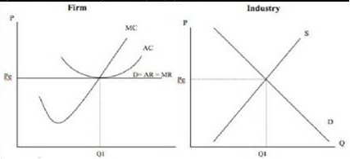
SHORT RUN EQULIBRIUM OF FIRM AND INDUSTRY
AR curve =MR curve
Firms are price takers, if one firm raises the price consumers will move to other firm
Creates a horizontal AR or Demand curve

Slide 6
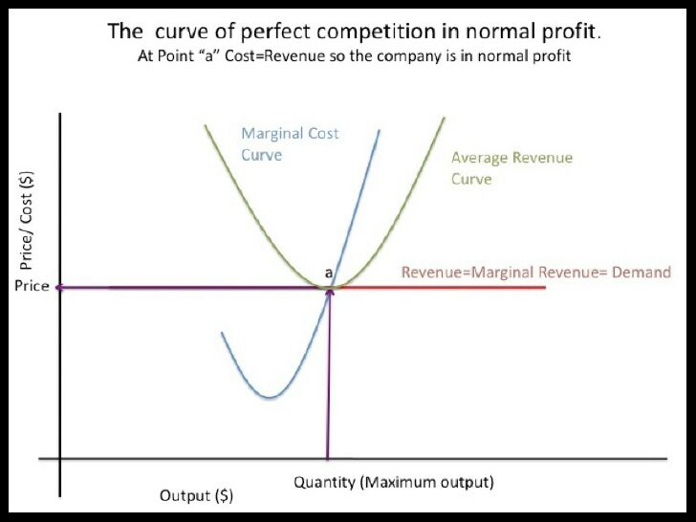
NORMAL PROFIT

Slide 7
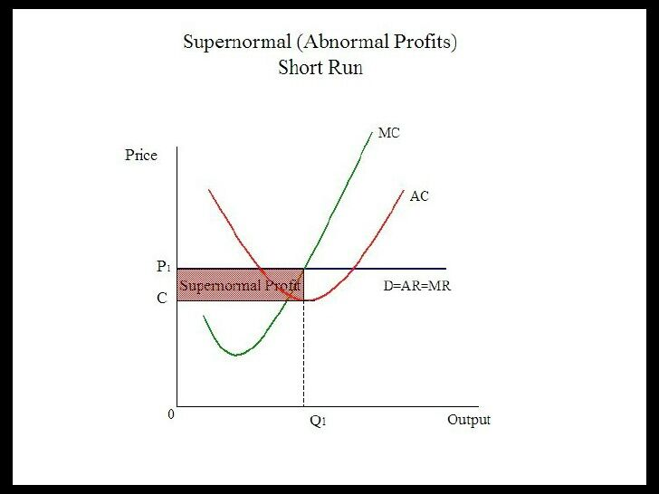
SUPER(ABNORMAL) PROFIT
Any profit above normal profit
Shortrun phenomenon

Slide 8
LOSS IN PERFECT COMPETITION
Demand falls results in price fall
Experiencing loss since AR<AC
Reflects entire market
As firms lose money, some firms leave the market
Results in shift in supply curve

Slide 9
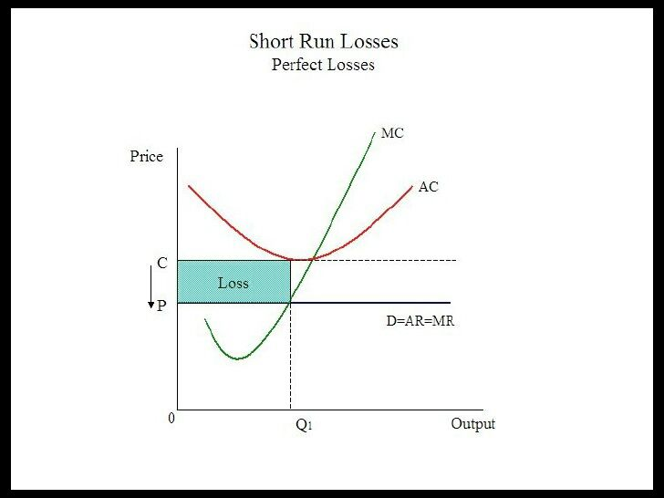

Slide 10
LONGRUN EQULIBRIUM (ENTRY OF FIRMS)
Seeing profits new firms enter
Supply increases (Supply curve shifts to right)
Price falls in the industry
Demand curve of each firm shifts downwards
Profits falls
Some firms face losses at this price and they exit
Normal profits exist in longrun

Slide 11
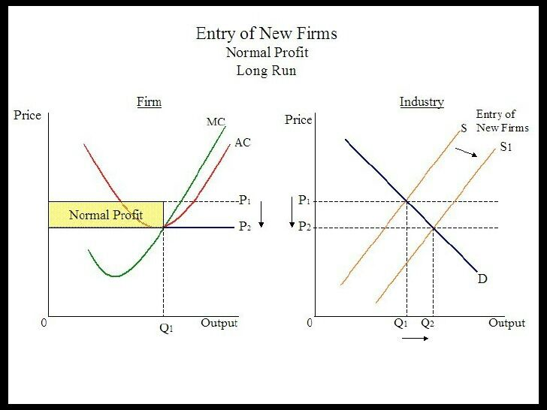

Slide 12
LONGRUN EQULIBRIUM (EXIT OF FIRMS)
At some price some firms face losses
They exit the industry
Supply of industry decreases(supply curve shifts to the left)
Price increases
Demand curve of each firm shifts upwards
Losses decreases until it reaches normal profit

Slide 13
