Slide 1
Welcome

Slide 2
Prabhu Jagatbandhu College

Slide 3
Socialization
Presented by -
Srija Chatterjee

Slide 4
A society is a group of people involved in persistent social interaction, or a large social groups sharing the same geographical or social territory, typically subject to the same political authority and dominant cultural expectations.
According to MacIver & Page,--
Society is a system. of usages and procedures, authority & mutual aid, of many groupings and divisions, of controls of human behavior and of liberties. This ever changing complex system which is called society is a web of social relationship.
Every society is faced with the necessity of making a responsible member out of each child born into it. The child must learn the expectations of the society so that his behaviour can be relied upon. He must acquire the group norms. The society must socialize each member so that his behaviour will be meaningful in terms of the group norms. In the process of socialization the individual learns the reciprocal responses of the society.

Slide 5
Socialization is a processes with the help of which a living organism is changed into a social being. It is a process through which the younger generation learns the adult role which it has to play subsequently. It is a continuous process in the life of an individual and it continues from generation to generation.
Socialization stands for the development of the human brain, body, attitude, behaviour and so forth. Socialization is known as the process of inducting the individual into the social world. The term socialization refers to the process of interaction through which the growing individual learns the habits, attitudes, values and beliefs of the social group into which he has been born.
According to Horton and Hunt,
Socialization is the process whereby one internalises the norms of his groups, so that a distinct ‘self emerges, unique to this individual.

Slide 6
Types of Socialization:
1. Primary Socialization:
Primary socialization refers to socialization of the infant in the primary or earliest years of his life. It is a process by which the infant learns language and cognitive skills, internalizes norms and values. The infant learns the ways of a given grouping and is molded into an effective social participant of that group.
The norms of society become part of the personality of the individual. The child does not have a sense of wrong and right. By direct and indirect observation and experience, he gradually learns the norms relating to wrong and right things. The primary socialization takes place in the family.
2. Secondary Socialization:
The process can be seen at work outside the immediate family, in the ‘peer group’. The growing child learns very important lessons in social conduct from his peers. He also learns lessons in the school. Hence, socialization continues beyond and outside the family environment. Secondary socialization generally refers to the social training received by the child in institutional or formal settings and continues throughout the rest of his life.

Slide 7
3. Adult Socialization:
In the adult socialization, actors enter roles (for example, becoming an employee, a husband or wife) for which primary and secondary socialization may not have prepared them fully. Adult socialization teaches people to take on new duties. The aim of adult socialization is to bring change in the views of the individual. Adult socialization is more likely to change overt behaviour, whereas child socialization moulds basic values.
4. Anticipatory Socialization:
Anticipatory socialization refers to a process by which men learn the culture of a group with the anticipation of joining that group. As a person learns the proper beliefs, values and norms of a status or group to which he aspires, he is learning how to act in his new role.
5. Re-socialization:
Re-Socialization refers to the process of discarding former behaviour patterns and accepting new ones as part of a transition in one’s life. Such re-socialisation takes place mostly when a social role is radically changed. It involves abandonment of one way of life for another which is not only different from the former but incompatible with it. For example, when a criminal is rehabilitated, he has to change his role radically.

Slide 8

Agencies of Socialization:
Family:
The family plays an outstanding role in the socialisation process. In all societies other agencies besides the family contribute to socialisation such as educational institutions, the peer group etc. But family plays the most important role in the formation of personality. By the time other agencies contribute to this process family has already left an imprint on the personality of the child. The parents use both reward and punishment to imbibe what is socially required from a child.
The family has informal control over its members. Family being a mini society acts as a transmission belt between the individual and society. It trains the younger generation in such a way that it can take the adult roles in proper manner. As family is primary and intimate group, it uses informal methods of social control to check the undesirable behaviour on the part of its members. The process of socialisation remains a process because of the interplay between individual life cycle and family life cycle.

Slide 9

2. Peer Group:
Peer Group means a group in which the members share some common characteristics such as age or sex etc. It is made up of the contemporaries of the child, his associates in school, in playground and in street. The growing child learns some very important lessons from his peer group. Since members of the peer group are at the same stage of socialisation, they freely and spontaneously interact with each other.
The members of peer groups have other sources of information about the culture and thus the acquisition of culture goes on. They view the world through the same eyes and share the same subjective attitudes. In order to be accepted by his peer group, the child must exhibit the characteristic attitudes, the likes and dislikes.

Slide 10
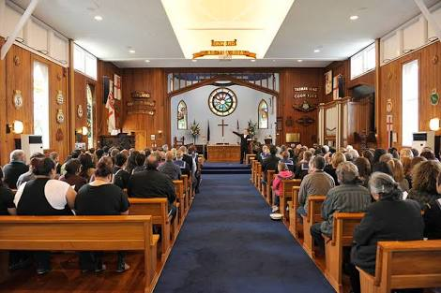
3. Religion:
Religion play a very important role in socialization. Religion instills the fear of hell in the individual so that he should refrain from bad and undesirable activities. Religion not only makes people religious but socializes them into the secular order.

Slide 11

4. Educational Institutions:
Parents and peer groups are not the only agencies of the socialisation in modern societies. Every civilised society therefore has developed a set of formalised agencies of education (schools, colleges and universities) which have a great bearing on the socialization process. It is in the educational institutions that the culture is formally transmitted and acquired in which the science and the art of one generation is passed on to the next.
The educational institutions not only help the growing child in learning language and other subjects but also instill the concept of time, discipline, team work, cooperation and competition. Through the means of reward and punishment the desired behaviour pattern is reinforced whereas undesirable behaviour pattern meets with disapproval, ridicule and punishment.

Slide 12
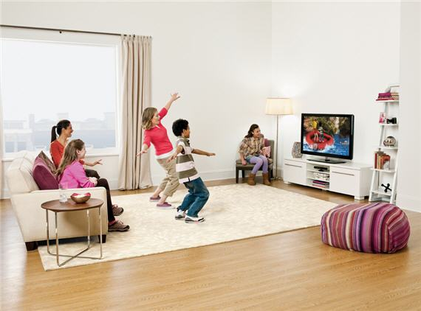
5. Mass Media:
The mass media of communication, particularly television, play an important role in the process of socialization. The mass media of communication transmit information and messages which influence the personality of an individual to a great extent.
In addition to this, communication media has an important effect in encouraging individuals to support the existing norms and values or oppose or change them. They are the instrument of social power. They influence us with their messages. The words are always written by someone and these people too – authors and editors and advertisers – join the teachers, the peers and the parents in the socialization process.
To conclude, environment stimuli often determine the growth of human personality. A proper environment may greatly determine whether the social or the self-centered forces will become supreme. Individual’s social environment facilitates socialization. If his mental and physical capacities are not good, he may not be able to make proper use of environment. However, the family plays perhaps the important part in the process of socialization.

Slide 13
Importance of Socialization:
The process of socialization is important from the point of view of society as well as from the point of view of individual. Every society is faced with the necessity of making a responsible member out of each child born into it. The child must learn the expectations of the society so that his behaviour can be relied upon.
He must acquire the group norms in order to take the behaviour of others into account. Socialization means transmission of culture, the process by which men learn the rules and practices of social groups to which belongs. It is through it that a society maintain its social system, transmits its culture from generation to generation.
From the point of view of the individual, socialization is the process by which the individual learns social behaviour, develops his self. Socialization plays a unique role in personality development of the individual.
The child has no self. The self emerges through the process of socialization. The self, the core of personality, develops out of the child’s interaction with others.
In the socialization process the individual learns the culture as well as skills, ranging from language to manual dexterity which will enable him to become a participating member of human society.
Socialization teaches skills. Only by acquiring needed skills individual fit into a society. In simple societies, traditional practices are handed down from generation to generation and are usually learned by imitation and practice in the course of everyday life.

Slide 14
Conclusions:
We are taught the rules of our society throughout our life.
We share cultural values with people around us.
Socialization gives us a social identity.
We may or may not be experiencing mind control- but if we are, we are probably not aware of it.

Slide 15
Thank You

