Slide 1
PowerPoint Presentation On
Shooting an Elephant
Prepared for the Students of Part II

Slide 2
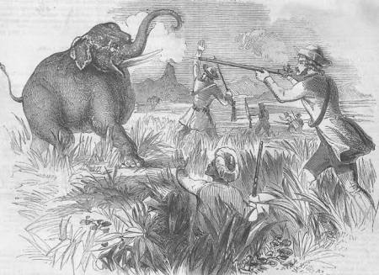
Shooting an Elephant
Author : George Orwell
Genre : Essay
Published in : New Writing
Year of Publication: 1936

Slide 3
List of Characters
George Orwell: Holds the central role being a police officer who despises the British imperial project in Burma in , sides with the Burmese, yet attempts to prove his authority to the Burmese.
The sub-inspector: A Burmese policeman who answers to Orwell . He’s waiting for Orwell at the bazaar where the elephant has been rampaging.
The Dead Man: A body trampled into mud by the rampaging elephant.

Slide 4

Themes
Themes
Imperialism
Colonial Discourses
Representation
Identity Politics
White Man’s Burden
Mimicry
Imperialism
Colonial Discourse
Representation
Identity Politics
White Man’s Burden
Mimicry

Slide 5
Plot
The narrative of the essay unpacks Orwell’s psychological conflict while performing his duty as a police officer for the British Raj in colonial Burma
In his role of representing the British Empire he upholds the stance of ‘ambivalence’
His ambivalent attitude is expressed in his confession of hatred for the colonial mission practicing entrenched hostility towards the colonised ‘other’ i.e. the Burmese people.

Slide 6
Plot
On the other hand the combination of his sympathetic gesture and resentment towards the Burmese people who never used to leave a scope to harass him further emphasizes his psychological dilemma.
Orwell himself becomes a subject being a part of the colonial mission justifying the ‘self-other’ binary.

Slide 7
Plot
In order to keep the narratives of colonial discourse undisturbed, he keeps on identifying the Burmese populace as images of ‘yellow faces’, mysterious beings, inborn liars, full of satanic litany and animalistic intent.
The politics of the accepted superiority of the Empire and the acknowledged inferiority of the Burmese people is further emphasized through the expression of their eager eyes ready to witness the theatre of killing of the elephant by the colonial master , represented by Orwell himself.

Slide 8
Plot
Orwell himself becomes the subject carrying the white man’s burden
His conflicted emotion reaches its height when he is to control the elephant undergoing a bout of “must” breaks its chain
His moral consideration holds him back from killing the elephant while his elevated status being a part of the imperialistic mission demands his coerssive performance to fulfil the demanding eyes of the ‘natives’

Slide 9
Plot
The dramatic act of killing the elephant by his repetitive application of bullets in disparate parts of the body earns him acclaim from the natives
The narrative ends with the question of aptness of the act of killing performed by Orwell, the colonial police officer who was to measure the value of life of the Burmese coolie whom the elephant trampled, with the value of the animal that he himself killed

Slide 10
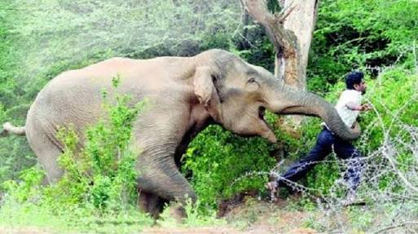
The Violent Act of the Rampaging Elephant

Slide 11
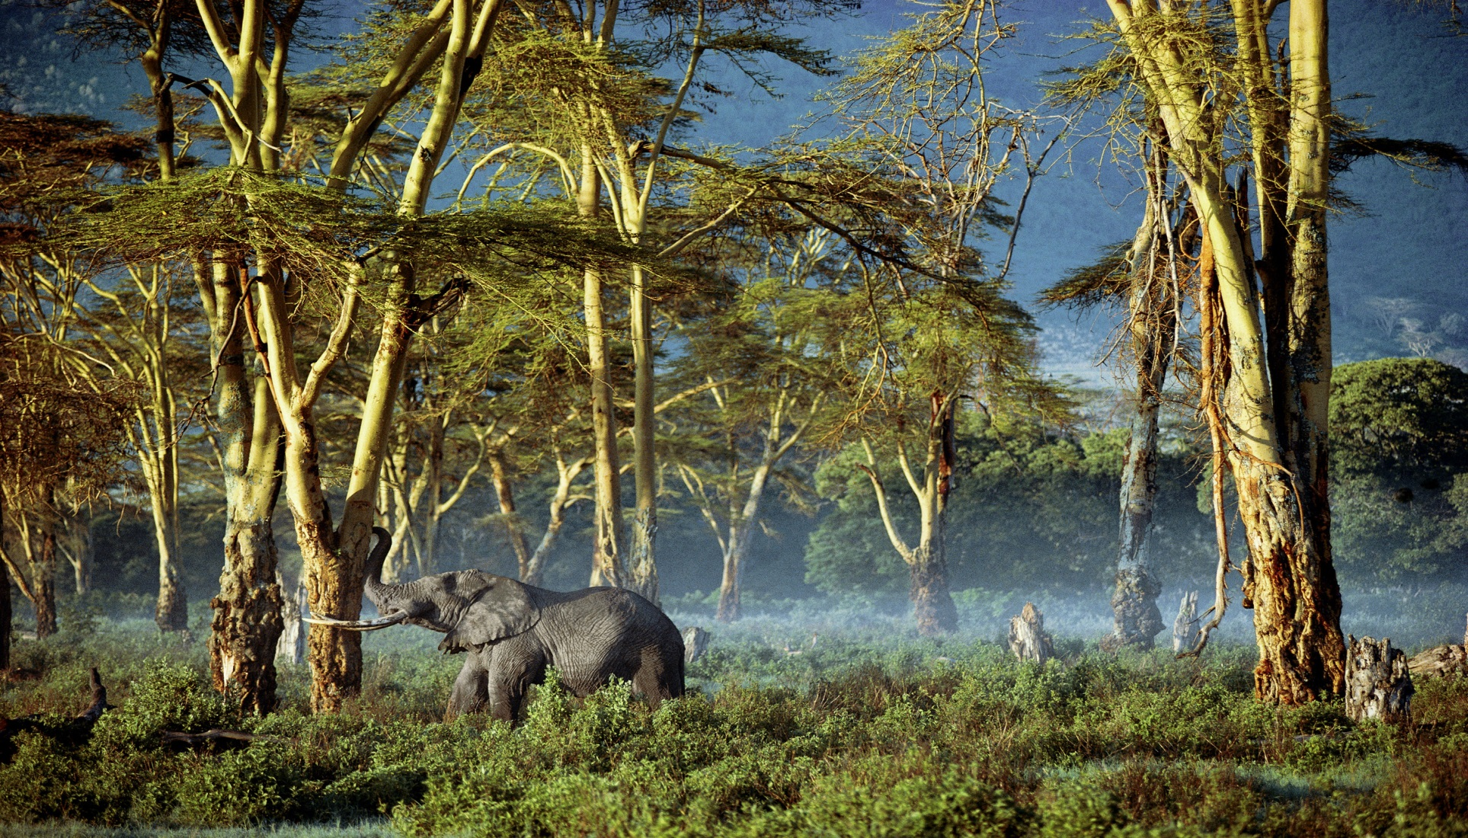
‘…peacefully eating, the elephant looked no more dangerous than a cow’

Slide 12
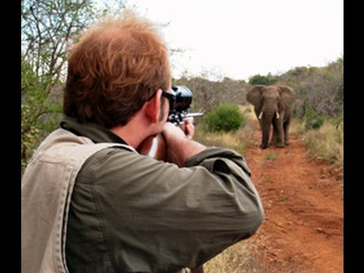
The Performance of Imperial Mission

Slide 13
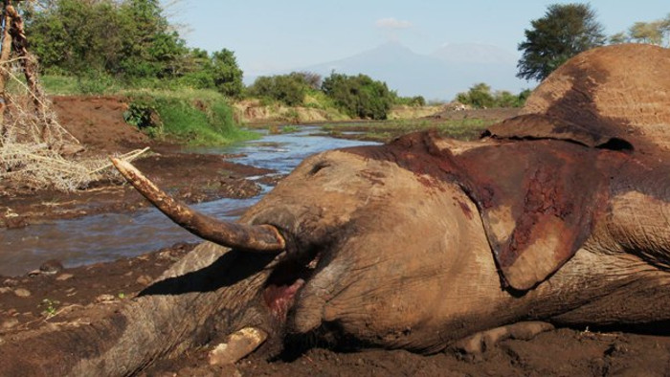
Justice is Done

Slide 14
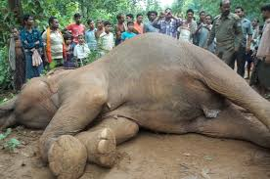
The Theatre of Killing

Slide 15
Use of Symbols and Motifs
The Policeman : As a police officer, Orwell’s presence holds symbolic power in Burmese society.
The tortured body: The image of the naked, scarred buttocks of a prisoner represents the power structure dominant in the Geographical domain referred to.
The Elephant : The rampaging elephant is a symbol of Burmese society , uncontrollable and violent , making itself known by jeers and humiliation.
The Crowd: As a motif the crowd reflects the eyes of Burmese society, closely observing their colonizers.

Slide 16
Allegory
The Act of Shooting the Elephant: The shooting of the elephant functions as an allegory for the British colonial project in Burma. Orwell psychological dilemma before killing the elephant represents the guilt of attempting to command over an entire culture and society.

Slide 17
Thank You

